Slide 1




The Illusion of Control:
Secrets Within Your Software Supply Chain
Derek E. Weeks
VP and Rugged DevOps Advocate
@weekstweets

Slide 2
Trust me. It’s not all about
SECURITY.
Notes:
My journey into DevOps

Slide 3

MY JOURNEY
into DevOps
Notes:
Ludicrous Speed.
Wave with Tremendous Energy
The greatest innovation wave the world has ever known. This wave is known as open source software manufacturing. Its tremendous energy is fueled by an enormous volume and variety of reusable parts.
The wave is not invincible. Two Big Weaknesses
But the wave is not invincible. It’s two big weaknesses are (1) parts are not created equal, and (2) parts age and grow stale quickly.

Slide 4
HIGH PERFORMERS
Where do they come from?
Notes:
Ludicrous Speed.
Wave with Tremendous Energy
The greatest innovation wave the world has ever known. This wave is known as open source software manufacturing. Its tremendous energy is fueled by an enormous volume and variety of reusable parts.
The wave is not invincible. Two Big Weaknesses
But the wave is not invincible. It’s two big weaknesses are (1) parts are not created equal, and (2) parts age and grow stale quickly.

Slide 5
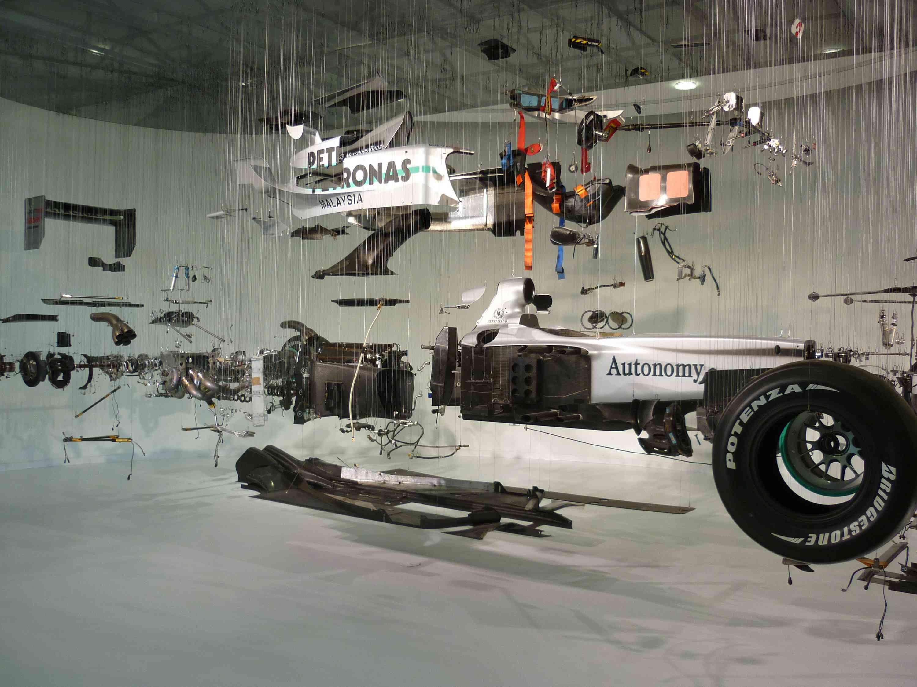
APPRECIATION OF THE SYSTEM
Do you know what you have?
Notes:
Appreciation of the system: Do you know what you have?
Visible Ops work that Gene Kim has done
Do you know what you have?
Do you know when it changes?
Are there patterns and benefits to make it go faster?

Slide 6
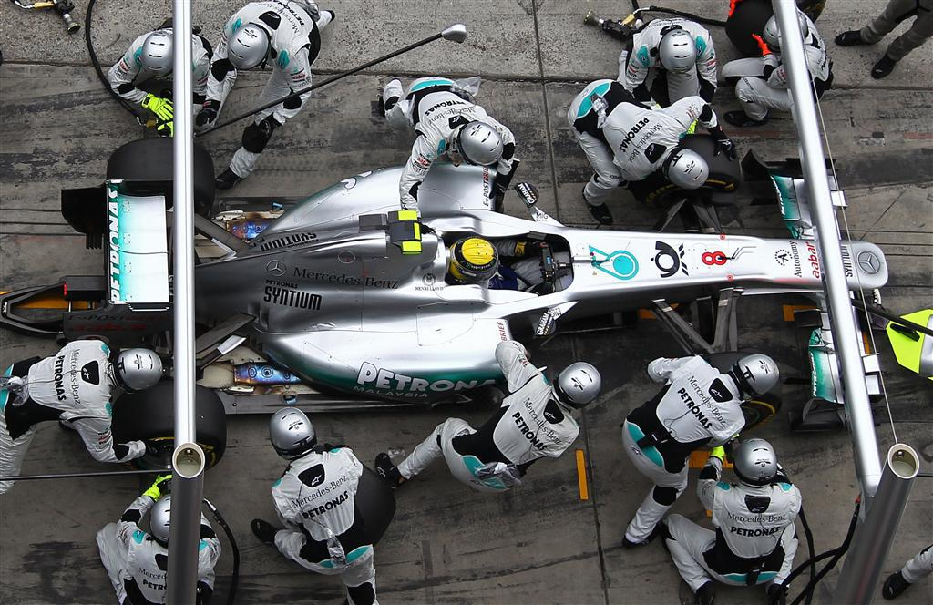
APPRECIATION OF THE SYSTEM
Do you know when it changes?
Notes:
Do you know when it changes?
Visible Ops work that Gene Kim has done
Do you know what you have?
Do you know when it changes?
Are there patterns and benefits to make it go faster?

Slide 7
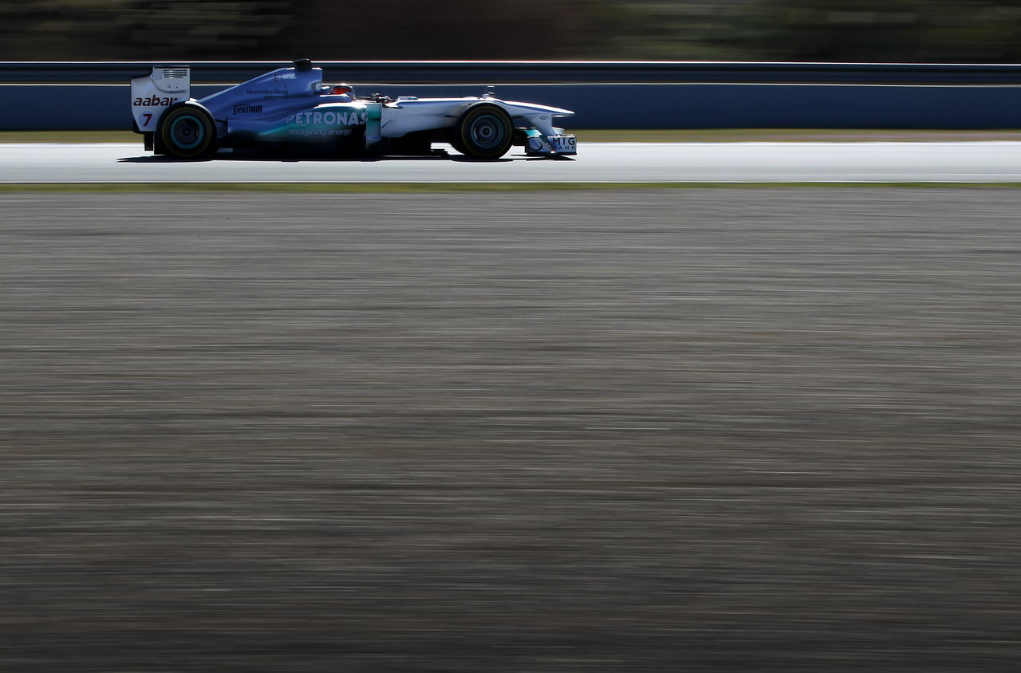
APPRECIATION OF THE SYSTEM
Can you make it faster?
Notes:
Visible Ops work that Gene Kim has done
Do you know what you have?
Do you know when it changes?
Are there patterns and benefits to make it go faster?

Slide 8
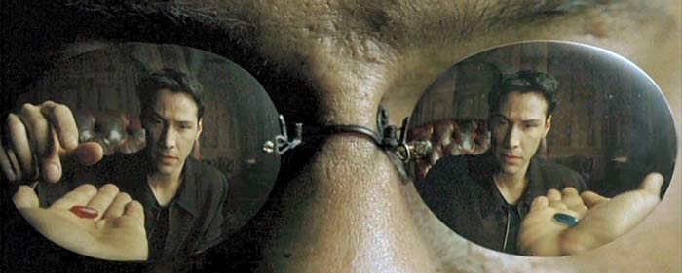
Notes:
"You take the blue pill, the story ends. You wake up in your bed and believe whatever you want to believe. You take the red pill, you stay in wonderland, and I show you how deep the rabbit hole goes."

Slide 9

YOUR REWARD
More Innovation.
Less Rework.
Notes:
Visible Ops work that Gene Kim has done
Do you know what you have?
Do you know when it changes?
Are there patterns and benefits to make it go faster?

Slide 10
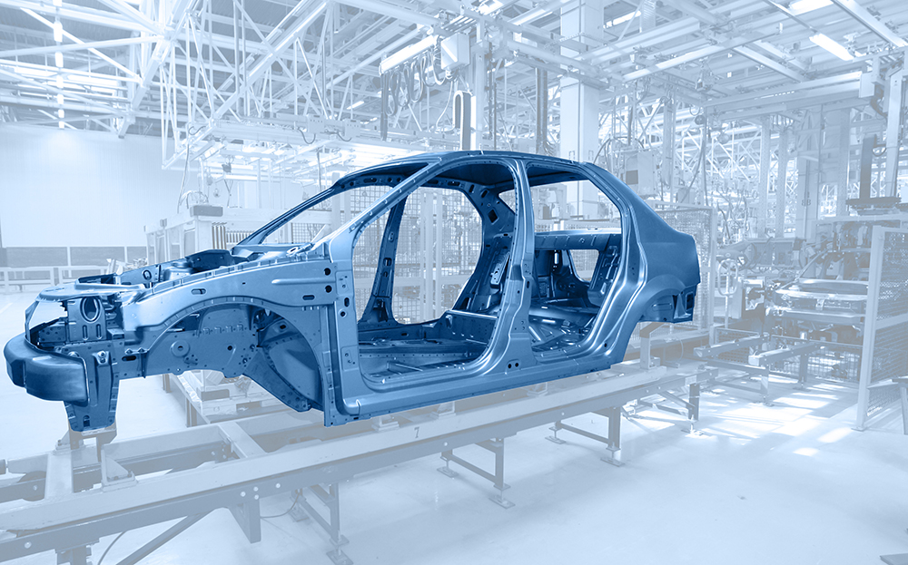
highest
quality
parts
fewest
and
best suppliers
visibility
and
traceability
@weekstweets

Slide 11
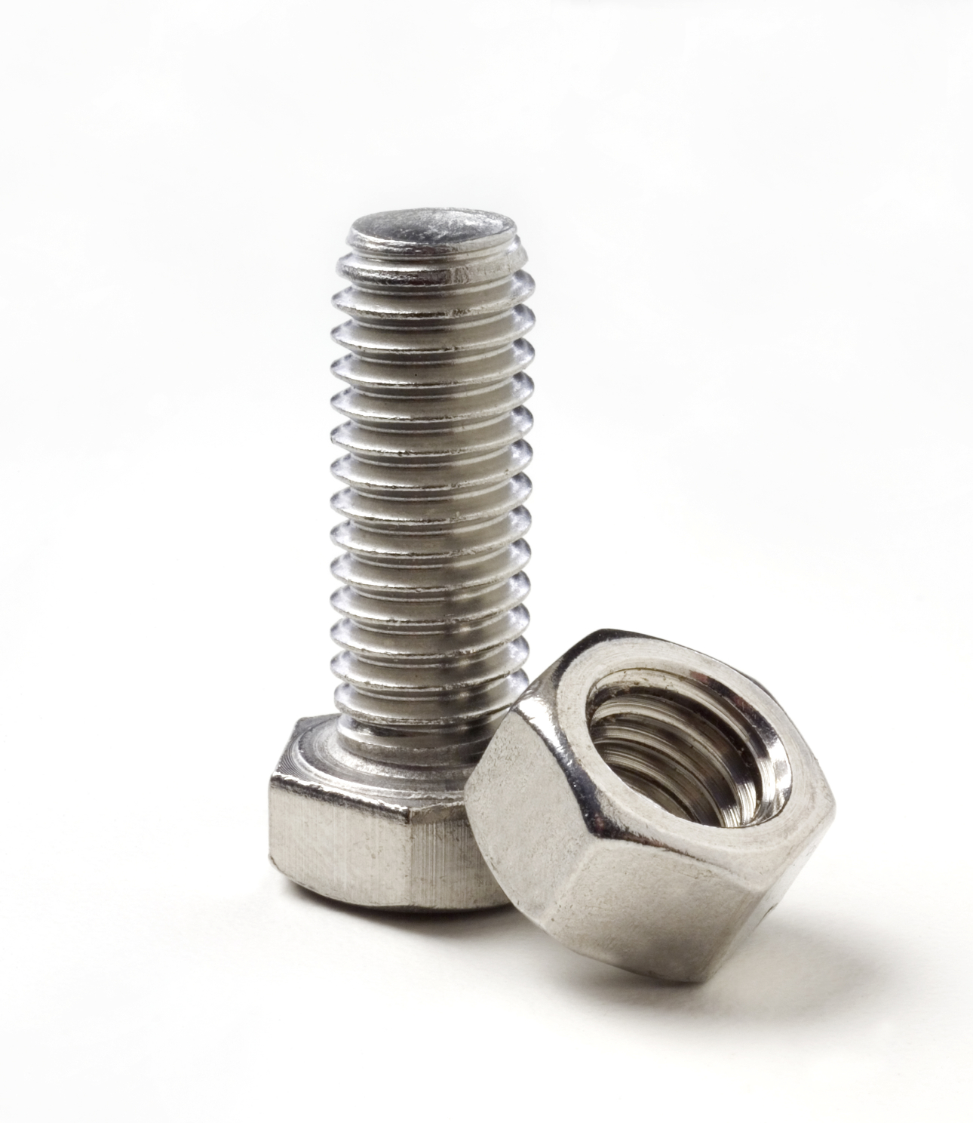
@sonatype

Slide 12
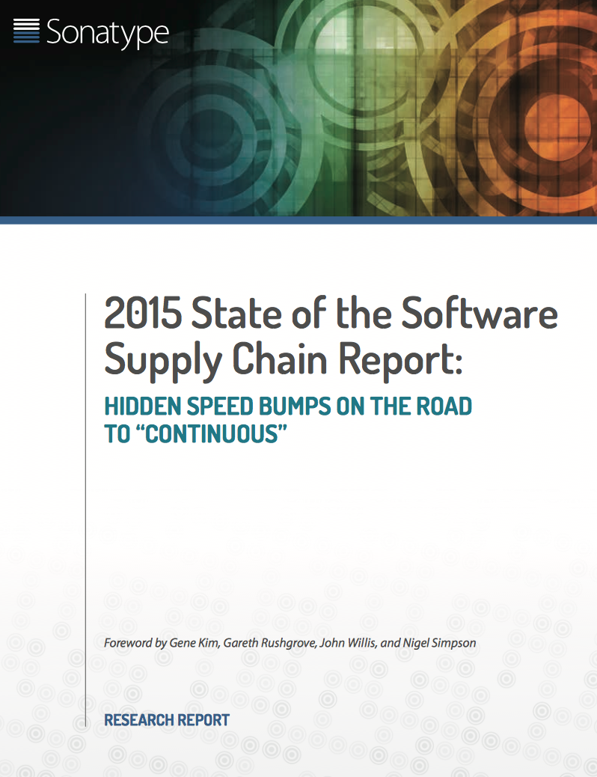
106,000
Organizations Analyzed
@weekstweets

Slide 13
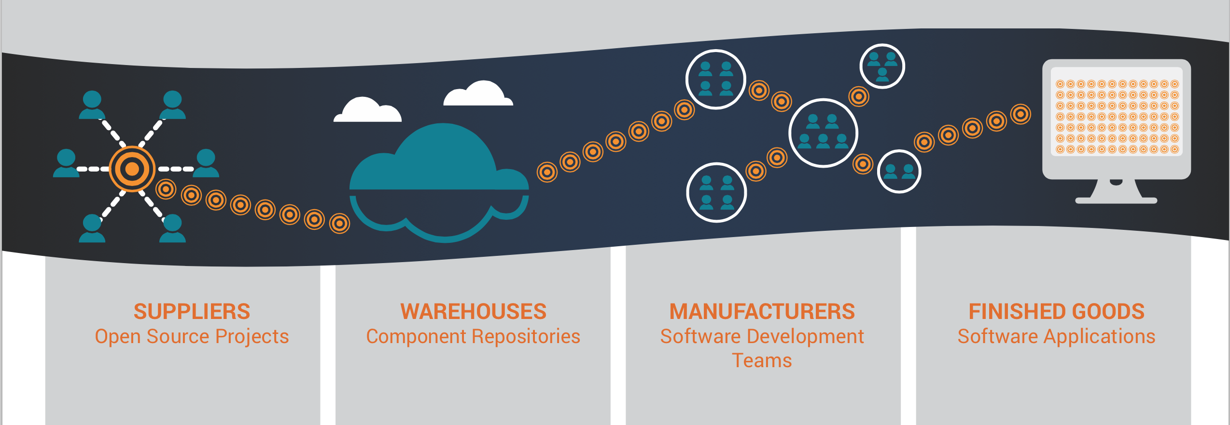
We all have a
software supply chain
@sonatype

Slide 14
New globe
Modern software development has changed
Our process hasn’t changed enough
Notes:
We are in the business of open source governance, management and compliance (add in slide or on cover slide)
Your Company Runs on Software – it must be trusted

Slide 15
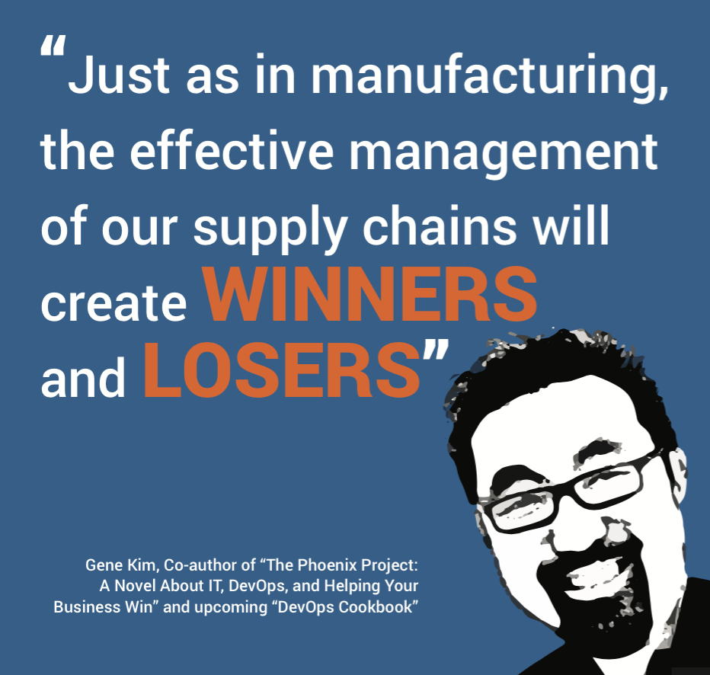



John Willis
Docker
Gareth Rushgrove
Puppet Labs
Nigel Simpson
Disney
@weekstweets

Slide 16

Open Source Download Requests…
2007
2008
2009
2010
2011
2012
2013
2014
2015
500M
1B
2B
4B
6B
8B
13B
17B
31B
@sonatype

Slide 17
Polling Question
What percent of modern apps are composed of open source components?
10 - 20%
50 - 60%
80 - 90%

Slide 18



How Dependent on 3rd Parties Are We?
Typical Application
10% Custom Written Code
90% From 3rd Parties
Open Source
Closed Source
Cloud Services
@weekstweets

Slide 19
AUTOMATE
AUTOMATE
AUTOMATE
highest
quality
parts
fewest
and
best suppliers
visibility
and
traceability
@weekstweets

Slide 20
@sonatype

Slide 21



CHANGE Typical component is updated 3 - 4X per year.
1,208,005 oss components
130,086 SUPPLIERS
11 million oss users
@sonatype
Notes:
The suppliers and the manufacturers need to share information. And right now that communication channel is not only broken, it simply doesn’t exist. Components are updated an average of 4X a year to fix issues, but how do the manufacturers even learn about it?
……..
Supply chain management at Toyota was transformational. They went from being a textile company to the world’s leading automobile manufacturer, largely because of these improvements and these principles. And even today, the effect of their philosophy is pretty remarkable to me. For example, Toyota-wide, they have 226 suppliers. General Motors has 5,500. And so imagine the efficiencies of only having to deal with 226 suppliers as opposed to 5,000. And what’s further to that, is that GM produces 54% of the content of their vehicles and Toyota produces 27%. So, GM has 1/20th the suppliers, and yet they produce half of the content of their vehicles. And so it’s no surprise that a Volt costs $40,000 and a Prius $20,000. And the Prius sells 20,000 units a month and GM sells 1,700.

Slide 22
Polling Question
How many open source suppliers do companies work with?
5,372
7,601
15,118

Slide 23
Suppliers Serving Manufacturers
 | Orders (downloads) | Suppliers (artifacts) | Parts (versions)
Average | 240,757 | 7,601 | 18,614
@sonatype

Slide 24
too much
WIP

Slide 25
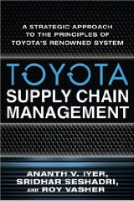
Comparing the Prius and the Volt
 | Toyota Advantage | Toyota Prius | Chevy Volt
Unit Cost | 61% | $24,200 | $39,900
Units Sold | 13x | 23,294 | 1,788
In-House Production | 50% | 27% | 54%
Plant Suppliers | 16% (10x per) | 125 | 800
Firm-Wide Suppliers | 4% | 224 | 5,500
Notes:
Comparing Toyota and General Motors
JOSH: Bring up:
Healthcare.gov
81 versions of Spring vs 1
15% Innovation lift at Insurer
MTTD 6 minutes versus 6 weeks

Slide 26
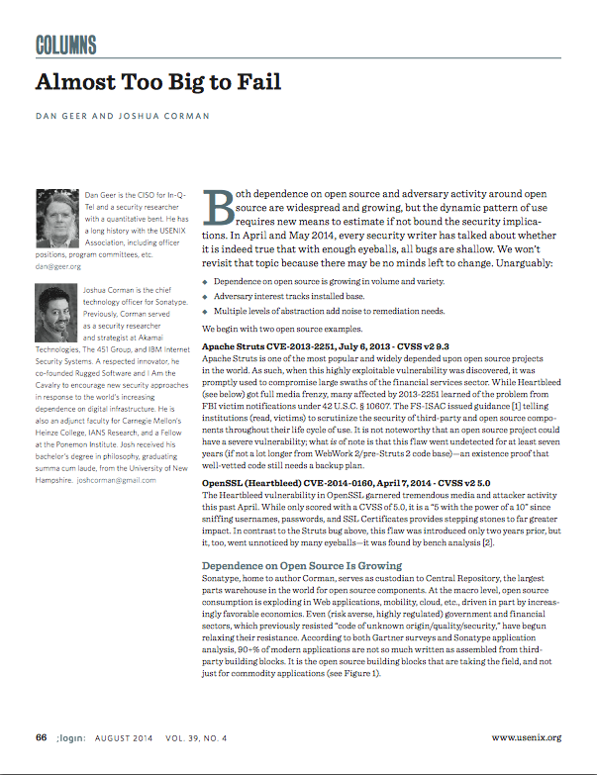
59%
never repaired
41%
390 days (median 265 days). CVSS 10s 224 days
<7
The best were remediated in under a week.
@sonatype

Slide 27
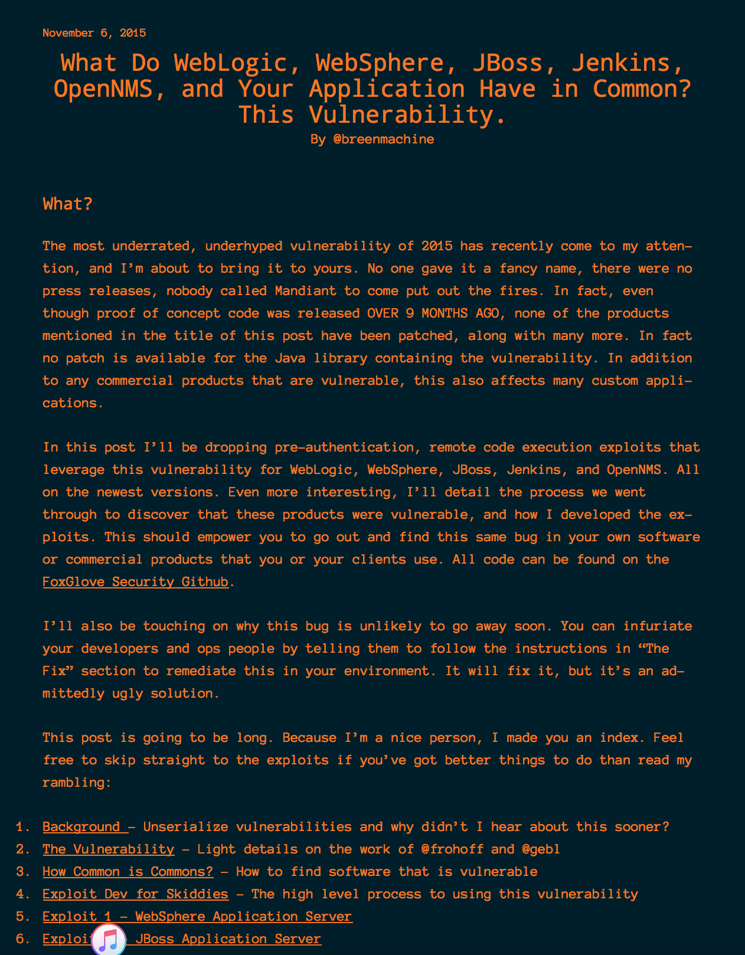

@sonatype

Slide 28
@sonatype

Slide 29

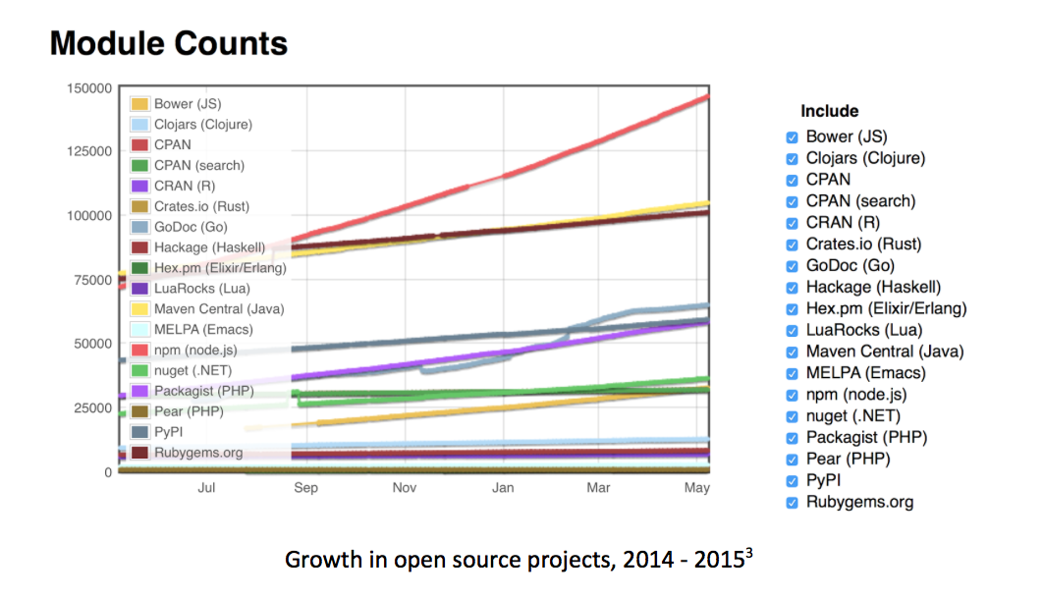
@sonatype

Slide 30
Sample of Open Source Repositories | 2014 Volume of Download Requests
Central.sonatype.org | 17,213,084,947
Npmjs.org | 15,460,748,856
NuGetGallery.com | 280,124,916
Bintray.com | 250,000,000
@sonatype

Slide 31
CHANGE Typical component is updated 3 - 4X per year.
1,208,005 oss components
Unlike COTS, there is no clear, effective
Communication channel
…but there can be.
11 million oss users
@sonatype
Notes:
The suppliers and the manufacturers need to share information. And right now that communication channel is not only broken, it simply doesn’t exist. Components are updated an average of 4X a year to fix issues, but how do the manufacturers even learn about it?
……..
Supply chain management at Toyota was transformational. They went from being a textile company to the world’s leading automobile manufacturer, largely because of these improvements and these principles. And even today, the effect of their philosophy is pretty remarkable to me. For example, Toyota-wide, they have 226 suppliers. General Motors has 5,500. And so imagine the efficiencies of only having to deal with 226 suppliers as opposed to 5,000. And what’s further to that, is that GM produces 54% of the content of their vehicles and Toyota produces 27%. So, GM has 1/20th the suppliers, and yet they produce half of the content of their vehicles. And so it’s no surprise that a Volt costs $40,000 and a Prius $20,000. And the Prius sells 20,000 units a month and GM sells 1,700.

Slide 32















Public Repos
Build Tool
PATTERN #1
Public
Repos
Local Repo
Build Tool
PATTERN #2
@sonatype

Slide 33
Polling Question
What percent of components are sourced from repository managers vs. other tools?
25%
55%
95%

Slide 34
95%
of downloads
Public Repos
Build Tool
5%
of downloads
Public
Repos
Local Repo
Build Tool
@sonatype

Slide 36
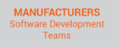
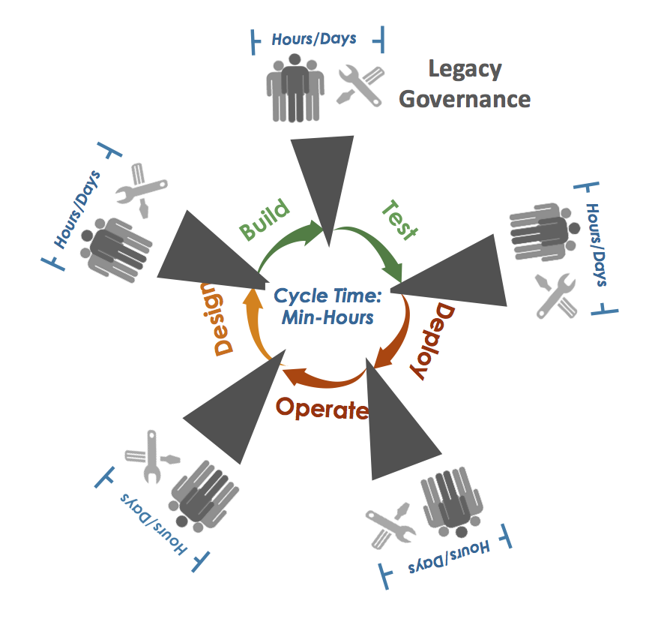
Oh, DevOps…
100-200
Cycle Time: Minutes-Hours
@weekstweets
Notes:
Cycle Time Squeeze
Work Arounds
Batch Scans
Rework
Exposure

Slide 37
Polling Question
What percent of organizations do not have a policy governing quality and integrity of components?
25%
55%
95%

Slide 38
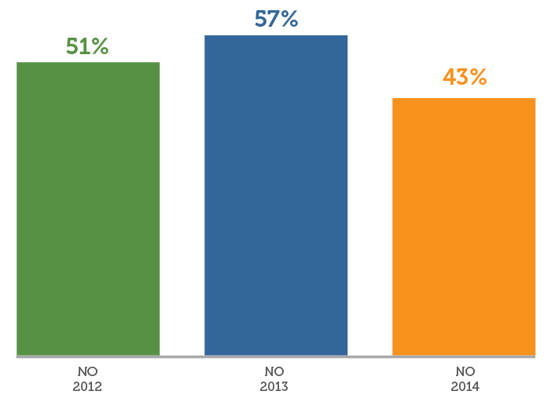
Half of organizations continue to run without an open source policy.
Q: Does your organization have an open source policy?
@sonatype
Source: 2012, 2013, 2014 Sonatype Open Source Development and Application Security Survey

Slide 39
If it does not fit,
it does not get done.
@sonatype
Notes:
Cycle Time Squeeze
Work Arounds
Batch Scans
Rework
Exposure

Slide 40
Download Volumes of Old CVEs
Orders | Quality Control
Average downloads | # with known vulnerabilities | % with known vulnerabilities | % known vulnerabilities (2013 or older)
240,757 | 15,337 | 7.5% | 66.3%
@sonatype

Slide 41
27
Outdated Versions Downloaded
@sonatype

Slide 42
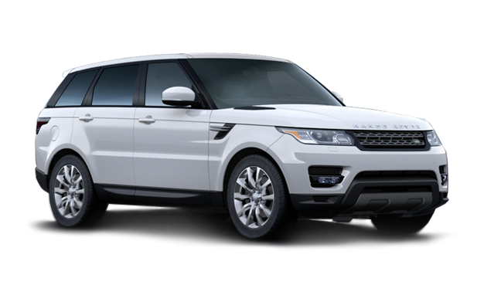
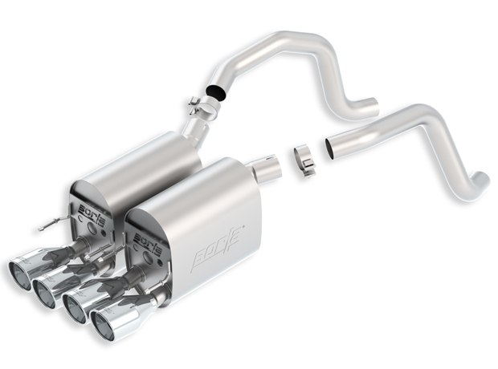
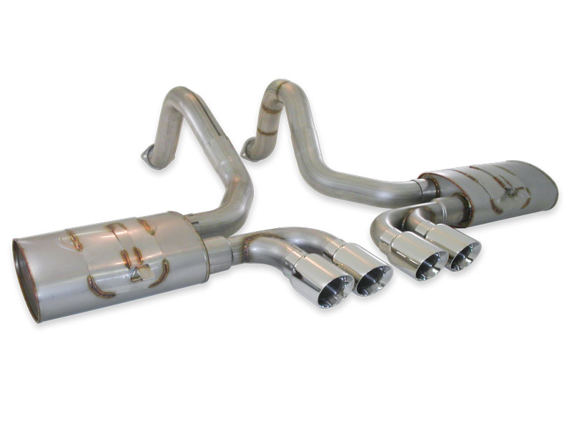
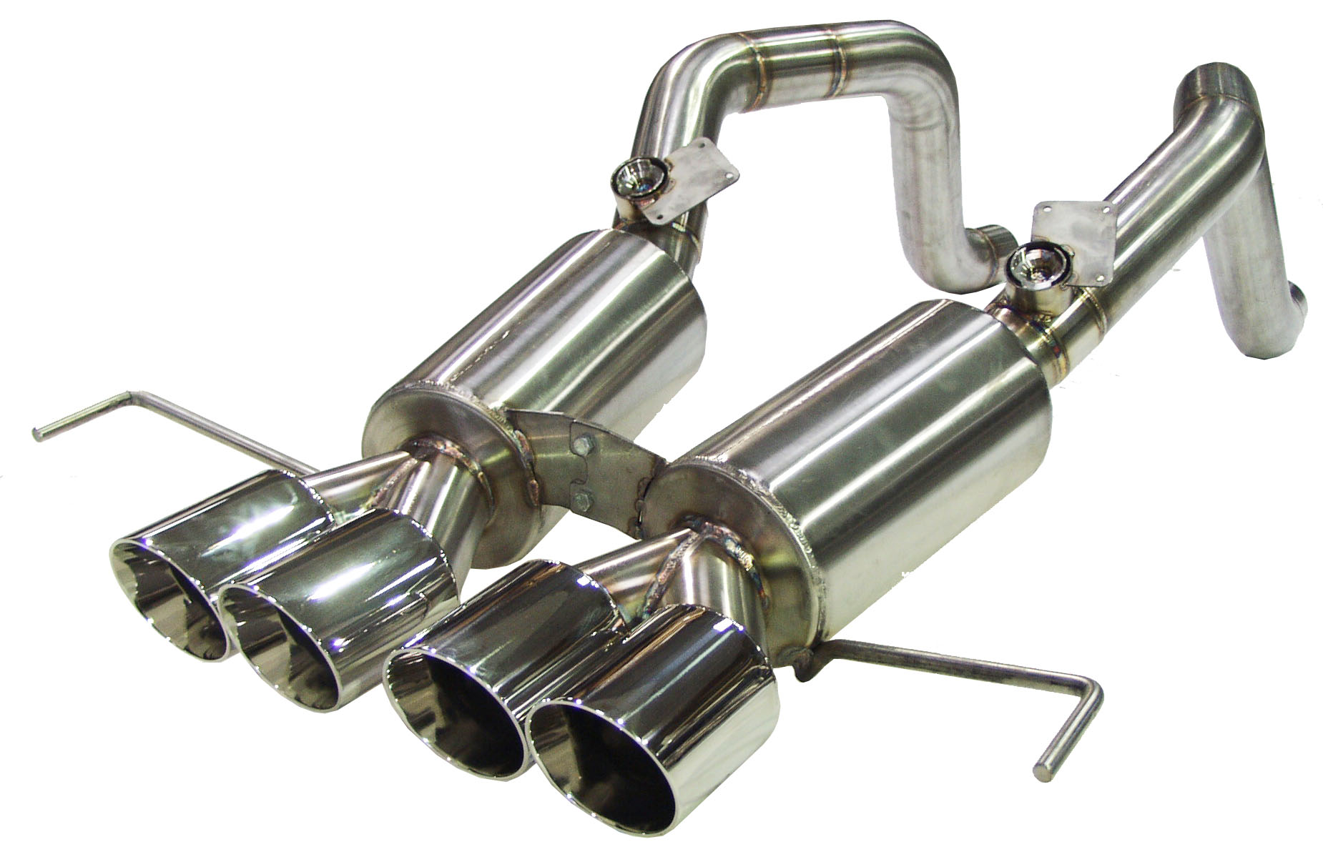
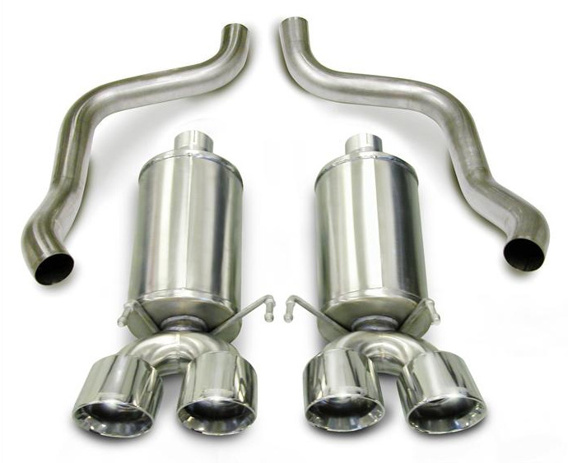
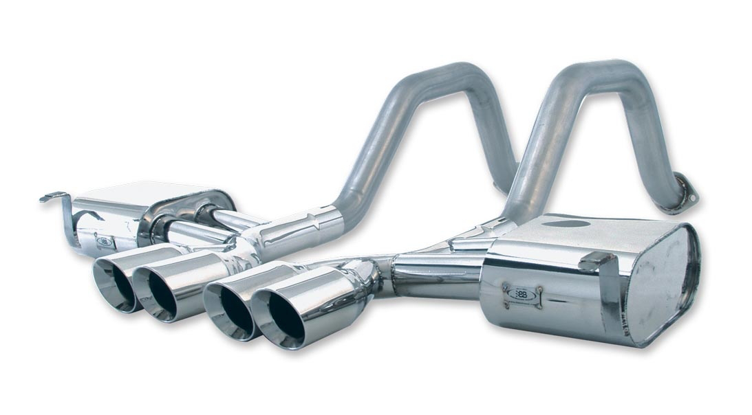
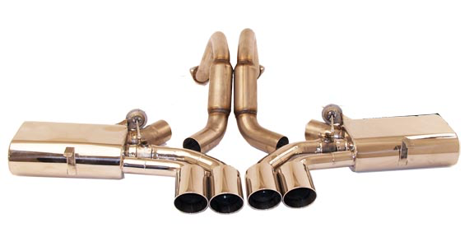
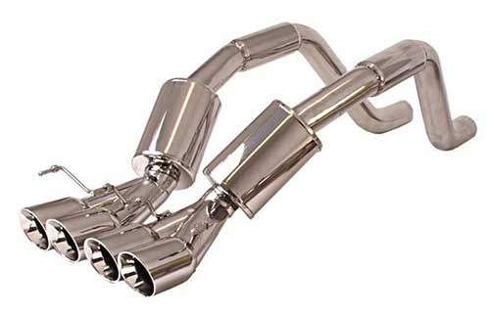
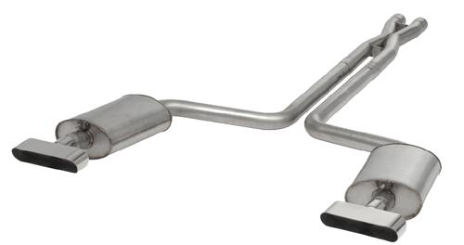
YOU WIN:
Taking meaningless work out of the system.
@sonatype
Notes:
You win when you protect the organization fwithout putting meaningless work into the IT system.
And you win even more when you take meaningless work out of the system.
Image Source: caranddriver.com

Slide 43
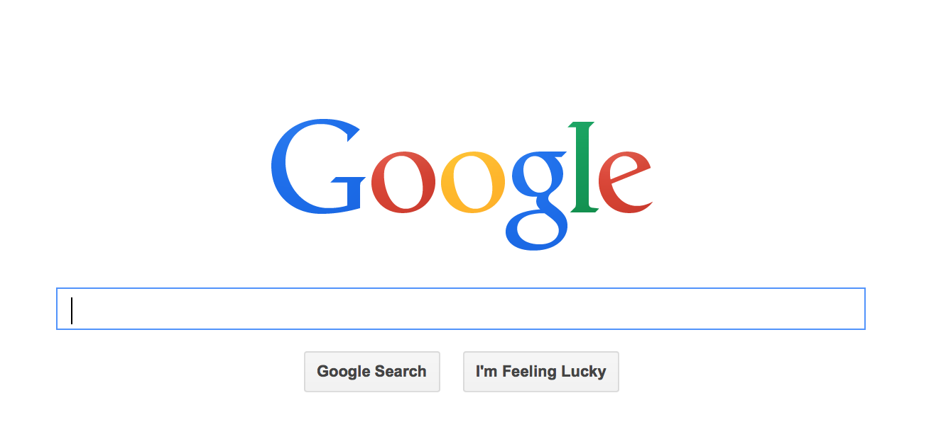
@sonatype

Slide 44

@sonatype

Slide 45
@sonatype

Slide 46
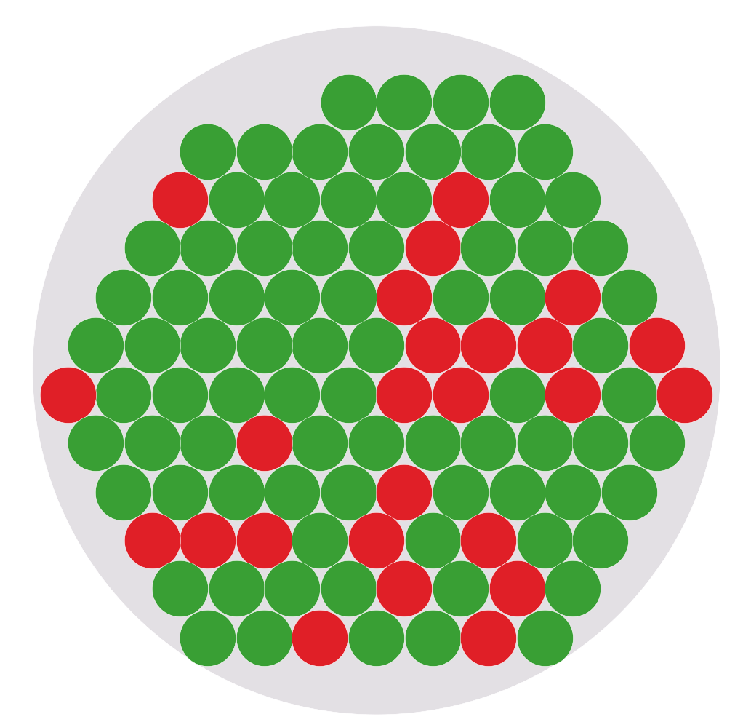

Analysis of 1,500+ applications…
@sonatype

Slide 47
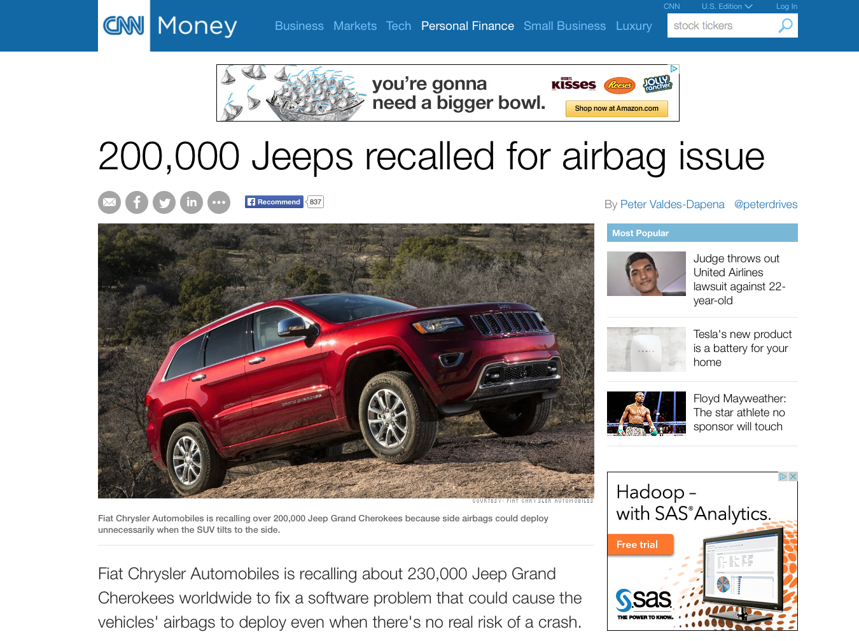
software glitch
v

Slide 48
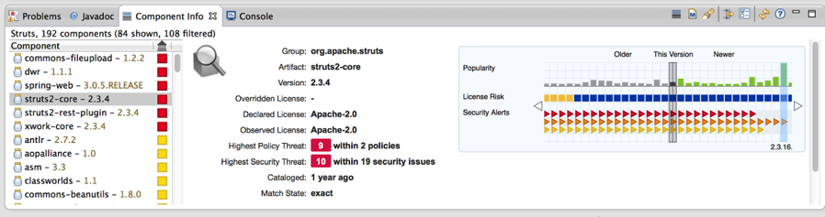
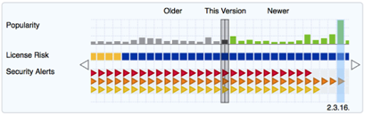
1
EMPOWER DEVELOPERS FROM THE START
ZTTR (Zero Time to Remediation)
@weekstweets
Notes:
First of all… when you can clearly see the threat levels of components in your IDE, you can easily shift to a safer one.
The area here in the lower right works like a slider… you simply slide to the right to identify a safer, accepted version of a component.
So you see, you not only see a potential problem early one, but you also see the solution.
Better yet…
=========
Click onto pane and zoom in and zoom out
Guide your eyes to the RIGHT….
This is a normal Developer IDE called Eclipse…
Sonatype made a PLUGIN within it to show a developer the component BEFORE before they choose or commit to ELECTIVE/AVOIDABLE Risk/AttackSurface/Complexity/LegalIssues …
The RED chain (e.g.) is every version of Strut2-core…. And if you move RIGHT far enough…. It will lack KNOW CRITICAL vulnerabilities.
The Green bar charts are the download popularity… which doesn’t speak at all to SECURITY… but may give people more comfort that it is stable and being used.
License rsik is based on self-defined policy – we track if the use of this license can cause your whole website to now be FREE common opensource – like GPL… which might be very bad for you… and a DIFFERENT type of risk…

Slide 49
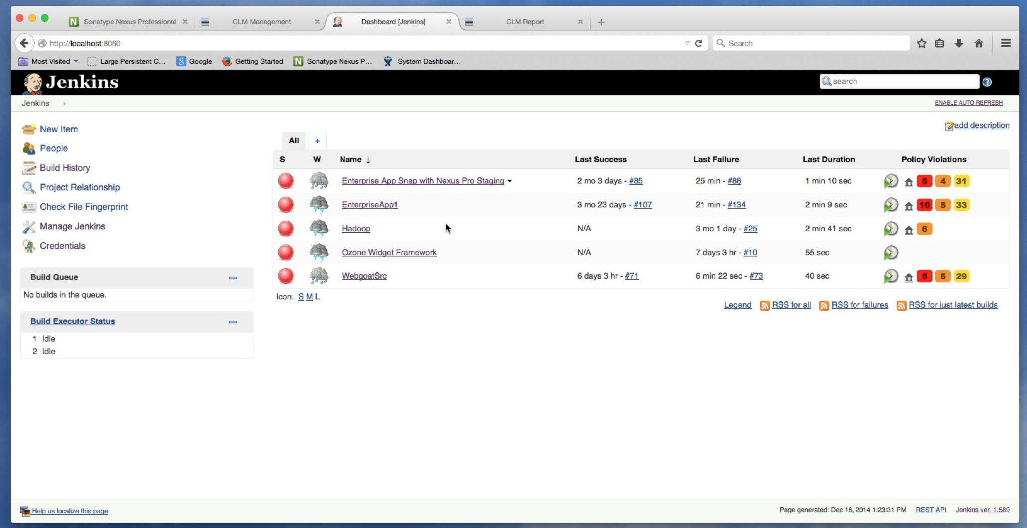
DESIGN A FRICTIONLESS APPROACH
2
@sonatype

Slide 50
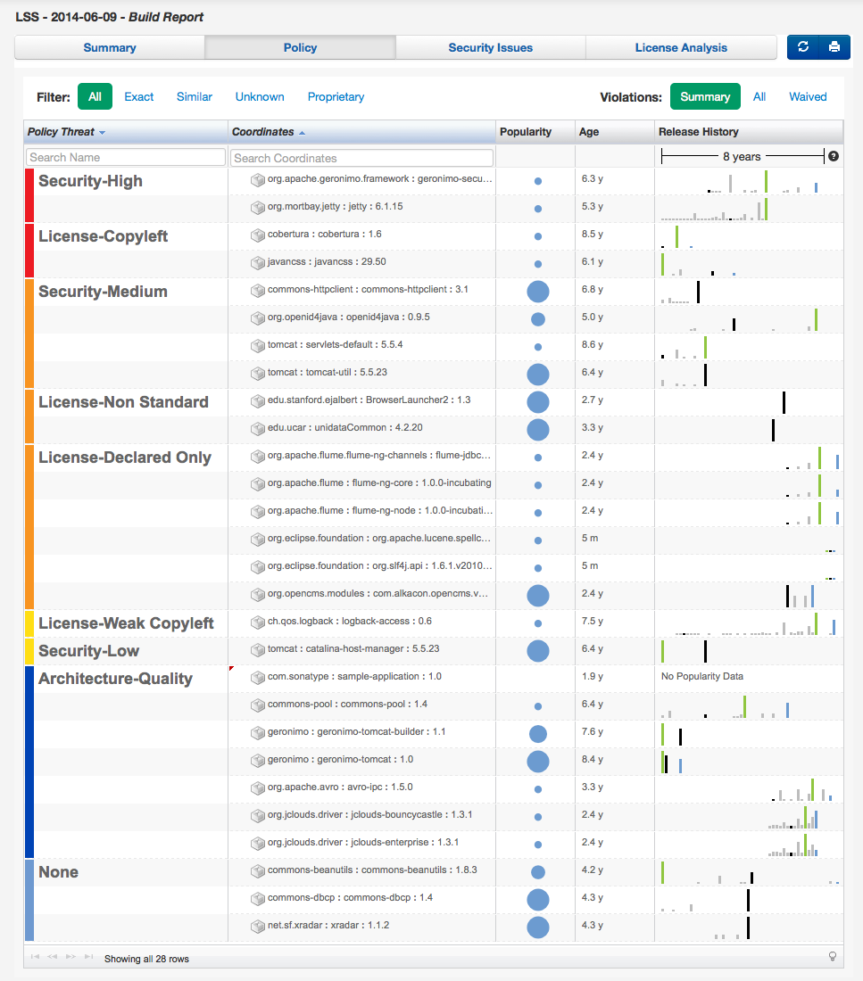
3
Create a software bill of Materials
@sonatype
bit.ly/softwareBOM

Slide 51
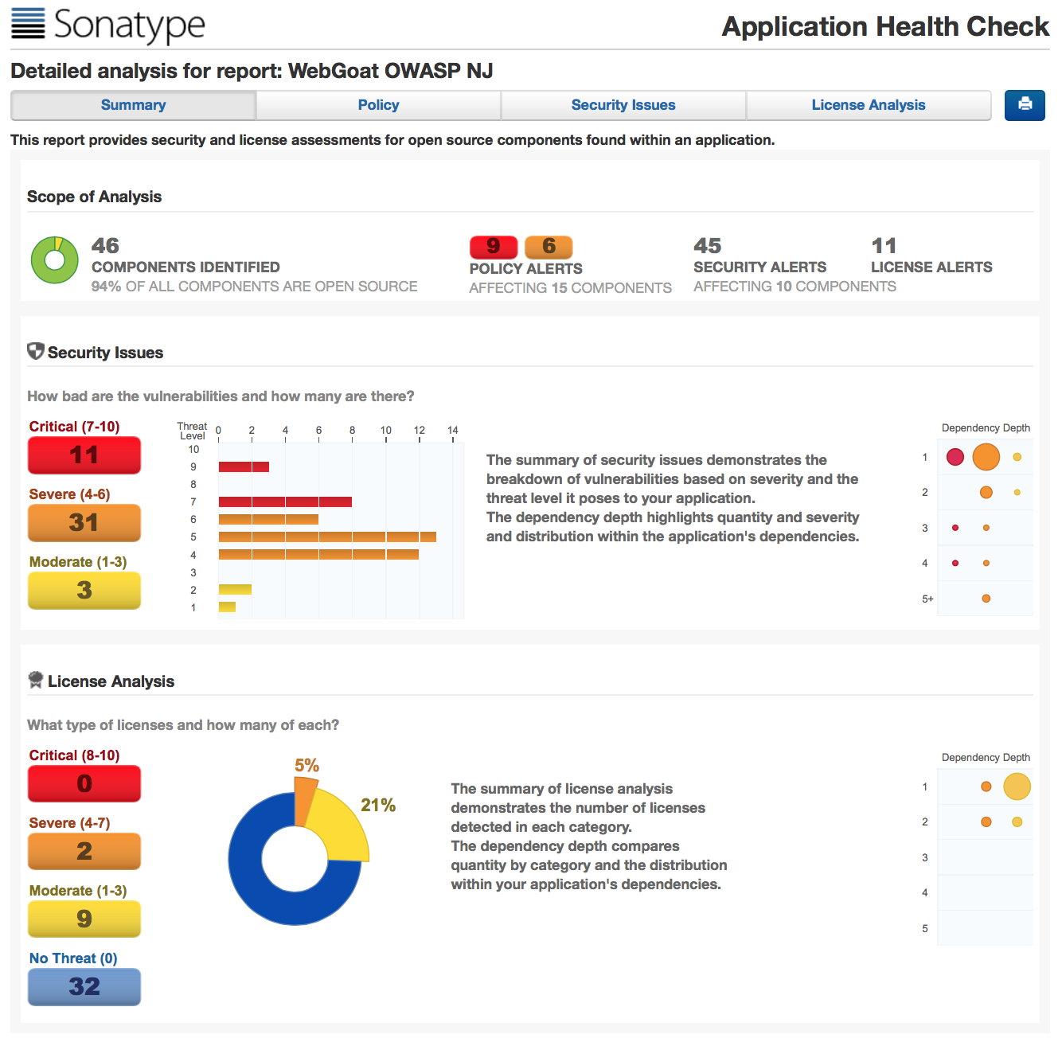
Your Bill of Materials:
bit.ly/Sonatype_BOM
Notes:
When do you have 5 minutes to spare?

Slide 52
GET MY SLIDES NOW:
weeks@sonatype.com
Notes:
When do you have an hour to spare?

